Slide 1

Combinatorial Problems
Permutations, Variations, Combinations and N choose K
SoftUni Team
Technical Trainers
Software University
http://softuni.bg

Slide 2
Have a Question?
sli.do
#Algorithms-Java

Slide 3
Table of Contents
Permutations
Variations
Combinations
N Choose K Count

Slide 4
Permutations

Slide 5
Permutations
Permutation of a set is, loosely speaking, an arrangement of its members into a sequence or linear order, or if the set is already ordered, a rearrangement of its elements.
There are two types of permutations
Without repetition
With repetition

Slide 6




Permutations
How to order them in three chairs

Slide 7
Permutations
How to order them in two chairs

Slide 8
Permutations
How to order him in one chair

Slide 9
Permutations

Slide 10
Permutations
Order A, B and C in all possible ways
A
B
C

Slide 11
Permutations
Order A, B and C in all possible ways
A
B
C
A | B
A | C
B | A
B | C
C | A
C | B

Slide 12
Permutations
Order A, B and C in all possible ways
A
B
C
A | B
A | C
B | A
B | C
C | A
C | B
A | B | C
A | C | B
B | A | C
B | C | A
C | A | B
C | B | A

Slide 13
Problem: Generate Permutations
Generates all possible permutations of a given set of elements
You can pick each item only once
A B C
A C B
B A C
B C A
C A B
C B A
A B C

Slide 14
Algorithm: Permutations
Algorithm permute(index) to generate variations P(n)
Put unused elements 0 … n-1 at position index
Mark/unmark elements as being used
Call permute(index + 1) to generate the rest of the array
permute(0)
permute(1)
permute(n)
print(); stop();
0… n - 1 | x | x | x | x
y
0… n - 1 | x | x | x | x
unused
unused
permute(1)
permute(2)

Slide 15
Generating Permutations
public static void permute(int index) { if (index >= elements.length) { print(); } else { for (int i = 0; i < elements.length; i++) { if (!used[i]) { used[i] = true; perm[index] = elements[i]; permute(index + 1); used[i] = false; } } } }

Slide 16
Permutations Count
Order A, B and C in all possible ways
How many ways are there?
A | B | C
3
2
1
n! = 3!
6 possible ways

Slide 17
Problem: Optimize Permutations
Generates all possible permutations of a given set of elements
Without using extra memory
A B C
A C B
B A C
B C A
C A B
C B A
A B C

Slide 18
Permutations: Swap Algorithm

Slide 19
Permutations: Swap Algorithm

Slide 20
Permutations: Swap Algorithm

Slide 21



Permutations: Swap Algorithm

Slide 22
Permutations: Swap Algorithm

Slide 23
Permutations: Swap Algorithm
Swap to previous combination on the way back

Slide 24
Permutations: Swap Algorithm

Slide 25
Permutations: Swap Algorithm

Slide 26
Permutations: Swap Algorithm
Swap to previous combination on the way back

Slide 27
Permutations: Swap Algorithm
Swap to previous combination on the way back

Slide 28
Permutations: Swap Algorithm

Slide 29
Permutations: Swap Algorithm

Slide 30
Permutations: Swap Algorithm

Slide 31
Permutations: Swap Algorithm

Slide 32
Problem: Optimize Permutations
Generates all possible permutations of a given set of elements
Without using extra memory
A B C
A C B
B A C
B C A
C A B
C B A
A B C

Slide 33
Generating Permutations
public static void permute(int index) { if (index >= elements.length) { System.out.println(String.join(" ", elements)); } else { permute(index + 1); for (int i = index + 1; i < elements.length; i++) { swap(index, i); permute(index + 1); swap(index, i); } } }

Slide 34
Problem: Permutations with Repetition
What about array = new int[] { A, B, B }
By definition: permutations { A, B', B'' } == { A, B'', B' }
Generate all permutations from a multi-set
A B B
B A B
B B A
A B B

Slide 35
Solution: Permutations with Repetition
public static void permuteWithRepetitions(int index) { if (index >= elements.length) { System.out.println(String.join(" ", elements)); } else { permuteWithRepetitions(index + 1); HashSet<String> swapped = new HashSet<>(); swapped.add(elements[index]); for (int i = index + 1; i < elements.length; i++) { if (!swapped.contains(elements[i])) { swap(index, i); permuteWithRepetitions(index + 1); swap(index, i); swapped.add(elements[i]); } } } }

Slide 36
Optimized: Permutations with Repetition
Algorithm permRep(s, e) permutes the items [s … e]
Exchange the item at positions l = k n-2 with items at l n-1
Call permRep(l + 1) to permute the rest of the array
permRep(0, n-1)
permRep(2, n-1)
permRep(n-1, n-1)
s
l
s
l
stop!
y | x | l | x | x | x
z | y | x | l | x | x
permRep(l + 1, n-1)
permRep(l+1, n-1)

Slide 37
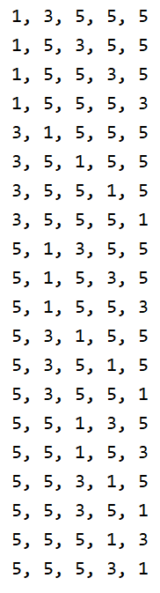
Generating Permutations with Repetition
static void permuteRep(int[] arr, int start, int end) { print(arr); for (int left = end - 1; left >= start; left--) for (int right = left + 1; right <= end; right++) { if (arr[left] != arr[right]) { swap(arr, left, right); permuteRep(arr, left + 1, end); } int firstElement = arr[left]; for (int i = left; i <= end - 1; i++) arr[i] = arr[i + 1]; arr[end] = firstElement; } }
int[] {3, 5, 1, 5, 5};
Arrays.sort(arr);
permuteRep(arr, 0, arr.length-1);

Slide 38
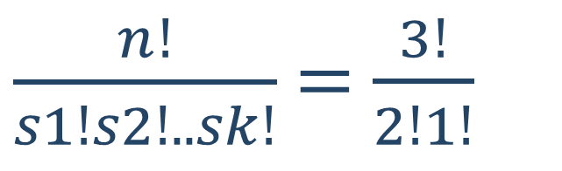
Permutations with Repetition Count
Order A, B and B in all possible ways
How many ways are there?
A | B | B
$\frac{n!}{s1!s2!..sk!}$ = $\frac{3!}{2!1!}$
3 different ways

Slide 39
Variations

Slide 40
Variations
Given set of elements N and K slots:
order the N elements in all the possible ways inside the K slots

Slide 41



Variations
Not enough chairs

Slide 42
Variations

Slide 43


Variations

Slide 44

Variations

Slide 45
Variations

Slide 46
Variations

Slide 47
Variations

Slide 48
Variations

Slide 49
Variations

Slide 50
Variations

Slide 51
Variations
Order A, B and C in all possible ways int k slots
Pick each item only once
A
B
C

Slide 52
Variations
Order A, B and C in all possible ways int k slots
Pick each item only once
A
B
C
A | B
A | C
B | A
B | C
C | A
C | B

Slide 53
Problem: Generate Variations
Generates all possible variations of k from a set of elements
You can pick an item once
A B
A C
B A
B C
C A
C B
A B C
2

Slide 54
Generating Variations
public static void variations(int index) { if (index >= kSlots.length) { System.out.println(String.join(" ", kSlots)); } else { for (int i = 0; i < elements.length; i++) { if (!used[i]) { used[i] = true; kSlots[index] = elements[i]; variations(index + 1); used[i] = false; } } } }

Slide 55

Variations Count
Order two from A, B, C and D in all possible ways
How many ways are there?
A | B | C | D
Multiply
4
3
$\frac{n!}{(n−k)!}$ = $\frac{4!}{2!}$
Twelve different ways

Slide 56
Variations with Repetitions
Order A, B and C in all possible ways into k slots
You can pick an item multiple times
A
B
C
A | A
A | B
B | A
B | B
C | A
C | B
A | C
B | C
C | C

Slide 57
Problem: Generate Variations with Reps
Generates all possible variations of a given elements
You can pick an item multiple times
A A
A B
A C
B A
B B
B C
C A
C B
C C
A B C
2

Slide 58
Generating Permutations
private static void variationsWithRep(int index) { if (index == k) { System.out.println(String.join(" ", variations)); } else { for (int i = 0; i < elements.length; i++) { variations[index] = elements[i]; variationsWithRep(index + 1); } } }

Slide 59
Variations with Reps: Iterative Algorithm
Generating the variations for n = 3 and k = 2
A | A
B | A
C | A
A | B
B | B
C | B
A | C
B | C
C | C

Slide 60
Variations with Reps: Iterative Algorithm
while (true) {
print(arr);
int index = k - 1;
while (index >= 0 && arr[index] == n-1)
index--;
if (index < 0)
break;
arr[index]++;
for (int i = index + 1; i < k; i++)
arr[i] = 0;
}
int n = 5;
int k = 3;
int[] arr = new int[k];
(0, 0, 0)
(0, 0, 1)
…
(4, 4, 2)
(4, 4, 3)
(4, 4, 4)

Slide 61
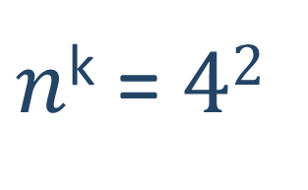
Variations Count
Order two from A, B, C and D in all possible ways
How many ways are there?
A | B | C | D
Multiply
4
4
Sixteen different ways
$n$^{k} = $42$

Slide 62

$$\frac{n!}{k!\left(n−k\right)! }$$
Combinations

Slide 63





Combinations
Pick up two to hang out

Slide 64
Combinations

Slide 65
Combinations

Slide 66
Combinations

Slide 67
Combinations

Slide 68
Combinations

Slide 69
Combinations

Slide 70
Combinations

Slide 71
Combinations

Slide 72
Combinations

Slide 73
Combinations

Slide 74
Combinations
Pick two form A, B and C
Order does not matter
A
B
C
A | B
A | C
B | C

Slide 75
Problem: Generate Combinations
Generates all possible combinations from a given elements
You can pick each item only once
A B
A C
B C
A B C
2

Slide 76
Algorithm: Combinations without Repetition
Algorithm comb(index, start)
Put the numbers i = start… n-1 at position index
Call comb(index + 1, i + 1) to generate the rest of the array

Slide 77
Combinations without Repetition
public static void comb(int index, int start) { if (index >= k) { print(kSlots); } else { for (int i = start; i < elements.length; i++) { kSlots[index] = elements[i]; comb(index + 1, i + 1); } } }

Slide 78
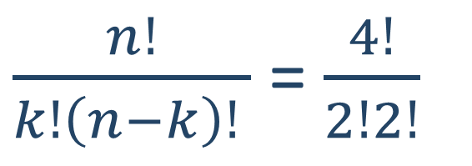
Combinations Count
Pick two from {A, B, C, D} in all possible ways, order does not matter
How many ways are there?
4
3
Variations n = 4, k = 2
2
1
Permutations of n = 2
$\frac{n!}{k!\left(n−k\right)! }$ = $\frac{4!}{2!2!}$
6 different ways

Slide 79
Algorithm: Combinations with Repetition
Algorithm comb(index, start)
Put the numbers i = start… n-1 at position index
Call comb(index + 1, i) to generate the rest of the array

Slide 80
Generate Combinations with Repetition
public static void comb(int index, int start) { if (index >= k) { print(kSlots); } else { for (int i = start; i < elements.length; i++) { kSlots[index] = elements[i]; comb(index + 1, i); } } }

Slide 81


N Choose K Count

Slide 82
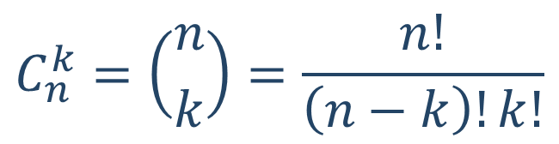
Problem: Combinations Count
How many combinations are there for n = 16, k = 15
Solution
How many ways to pick 15 items?
Divide by the number of ways in which you can arrange 15 numbers
Possible combinations → 16
$$C_{n}^{k}=\left({n \atop k}\right)=\frac{n!}{\left(n−k\right)!k!}$$
16 * 15 * 14 * … * 2
15 * 14 * 13 * … * 1

Slide 83
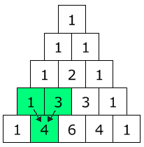
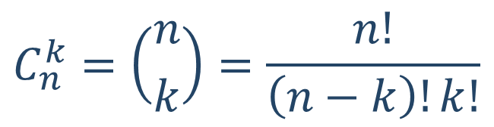
Pascal's Triangle
Each node → how many ways are there to reach it?
Quickly find N choose K count
Go down to row n (the top row is 0)
Move along k places to the right
The value there is your answer
$$C_{n}^{k}=\left({n \atop k}\right)=\frac{n!}{\left(n−k\right)!k!}$$

Slide 84
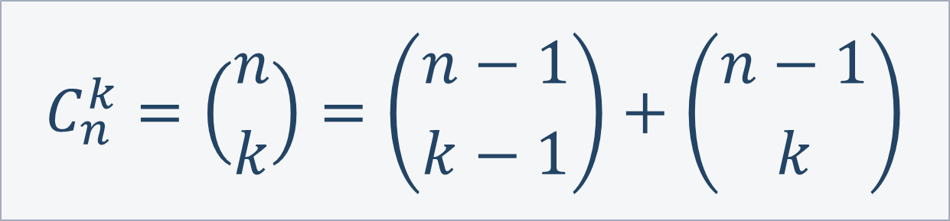
Binomial Coefficients: Calculation
$$C_{n}^{k}=\left({n \atop k}\right)=\left({n−1 \atop k−1}\right)+\left({n−1 \atop k}\right)$$
Base cases:
if k > n → 0
if k == 0 → 1
if k == n → 1

Slide 85
Binomial Coefficients: Calculation
public static binom(int n, int k) {
if (k > n)
return 0;
if (k == 0 || k == n)
return 1;
return binom(n - 1, k - 1) + binom(n - 1, k);
}
This is exponential, we can do way better with dynamic programming

Slide 86

Summary
…
…
…
Permutations – Ways to order n elements
Variations – Ways to order k of n elements
Combinations – Ways to choose k of n elements
Pascal's Triangle
Binomial Coefficients () – N choose K Count

Slide 88










SoftUni Diamond Partners

Slide 89



Educational Partners

Slide 90

License
This course (slides, examples, demos, videos, homework, etc.) is licensed under the "Creative Commons Attribution-NonCommercial-ShareAlike 4.0 International" license

Slide 91





Trainings @ Software University (SoftUni)
Software University – High-Quality Education, Profession and Job for Software Developers
softuni.bg
Software University Foundation
http://softuni.foundation
Software University @ Facebook
facebook.com/SoftwareUniversity
Software University Forums
forum.softuni.bg

